Slide 1
NYC House Pricing Prediction
Mid-stage report
Presented by Yifan Ding, Xinqi Bao and Zimo Liu

Slide 2
Introduction
We already know that the house pricing is influenced by many features.
1.Which one will be the most relevant factor to the house price?
2.What kind of model should be chosen?
3.How can we improve the accuracy of the model?
These are the problems which we need to solve in this project.

Slide 3
Description of data set
This dataset is a record of every building or building unit (apartment, etc.) sold in the New York City property market over a 12-month period.
This dataset contains the location, address, type, sale price, and sale date of building units sold.
Many sales occur with a nonsensically small dollar amount: 0 dollar most commonly. These sales are actually transfers of deeds between parties: for example, parents transferring ownership to their home to a child after moving out for retirement.

Slide 4
Data Analysis and Processing

Slide 5
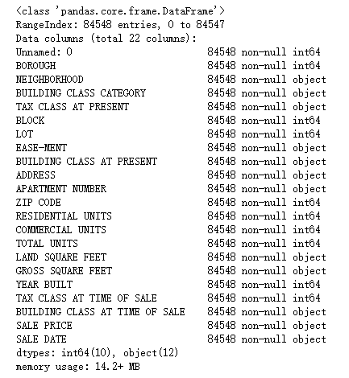
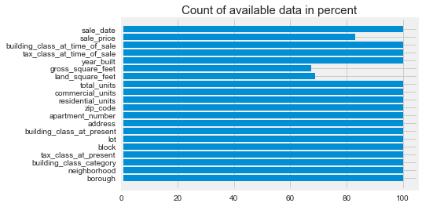

Slide 6
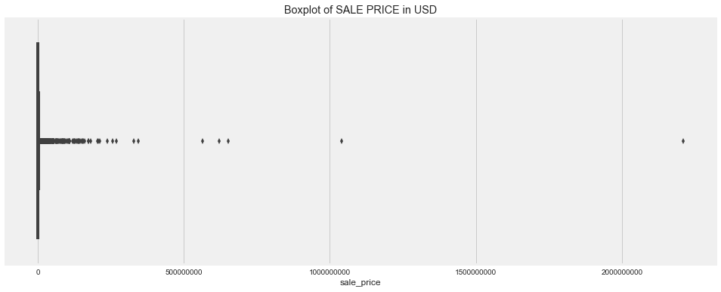
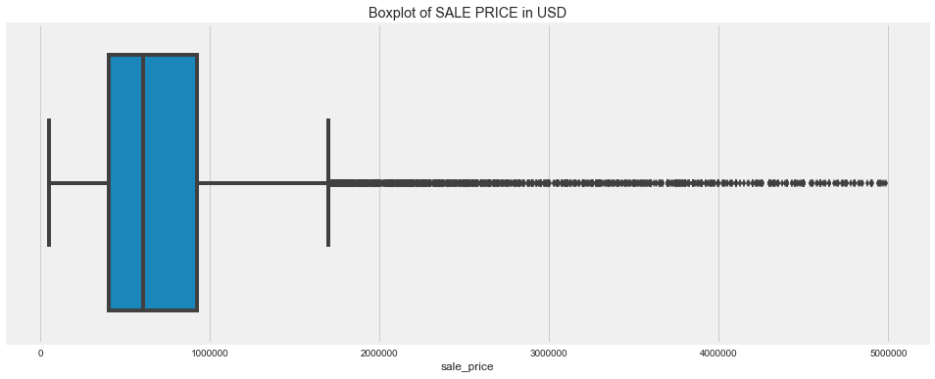
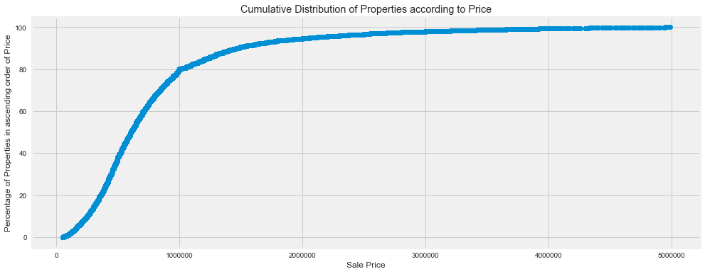
Little amount of numbers are extreme big or 0
By limiting the range to remove these “bad” data

Slide 7
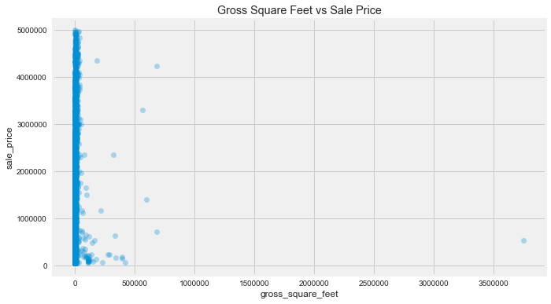
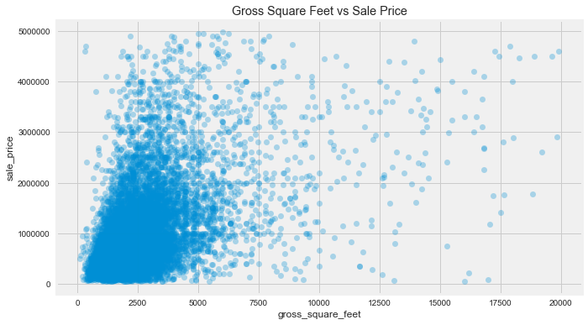
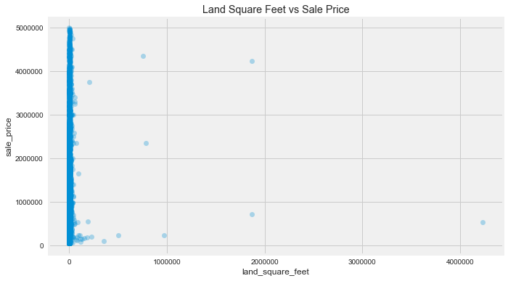
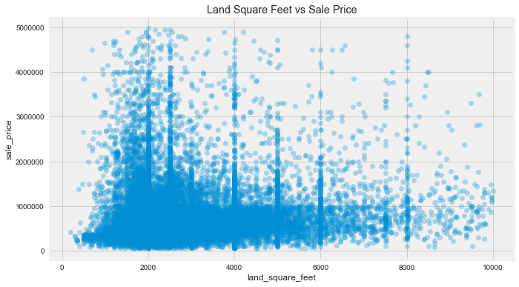

Slide 8
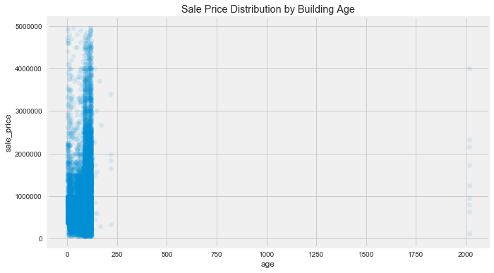
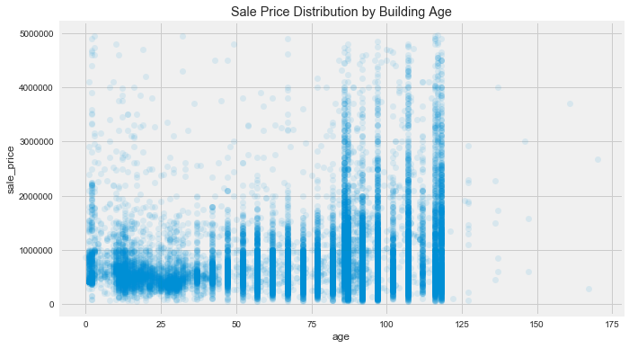

Slide 9
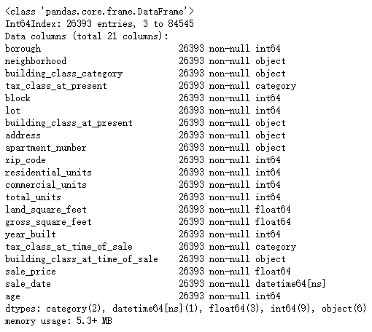
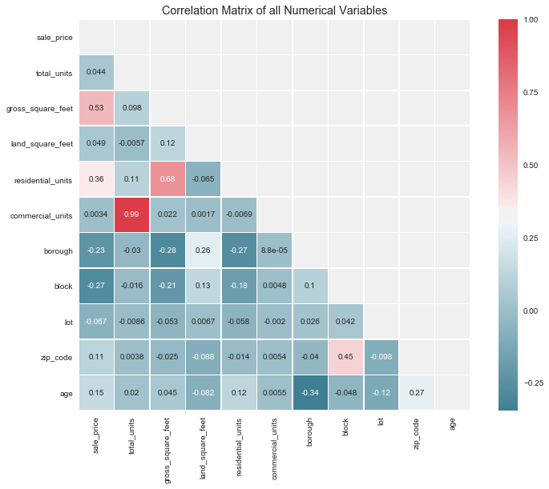

Slide 10
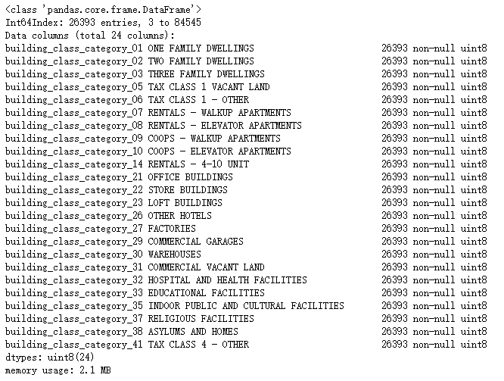
Split category to different columns

Slide 11
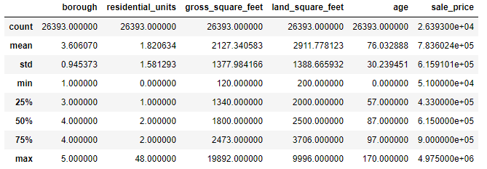
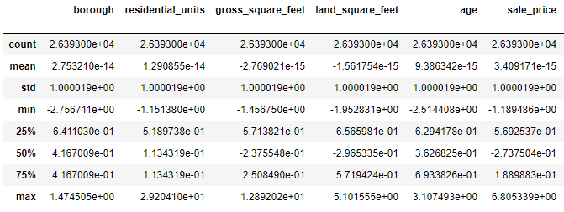
Some columns’ data are too big compared with others
Scaling them to a fixed range

Slide 12
Machine Learning Algorithms
Random Forest Regressor:
Many features: borough, building class category, age, etc.
Independent trees, random select features, parallel training which is fast.
Not sensitive to anomalies and outliers.
Great generalization ability.
Can get feature importance.

Slide 13
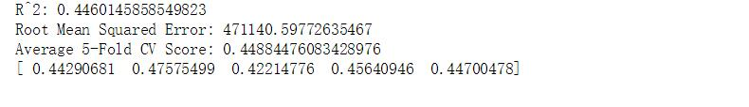
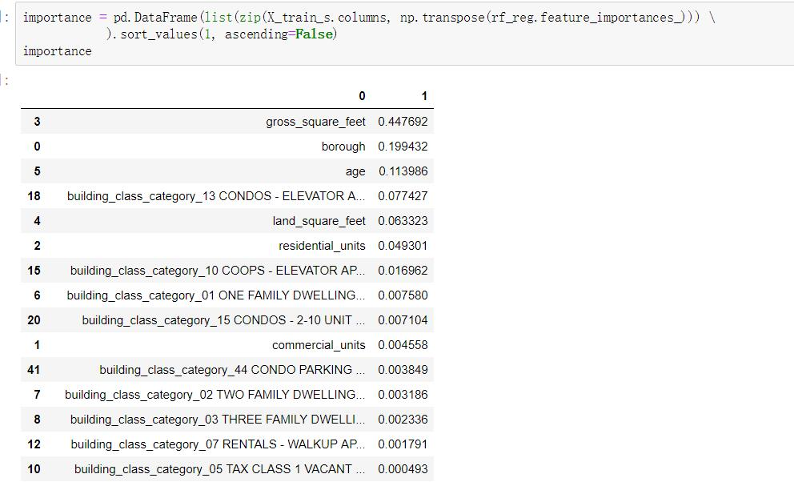
Some early implementation results that you may have got
First, after EDA, dealing with the missing values and outliers, we just applying the RF regressor simply. The result is not very well.
Second time we use one-hot encode method to transfer category type feature to many new features which is good for modeling. And we use gridsearchCV to prune the parameters of the trees, like min_samples_leaf, min_samples_split.

Slide 14
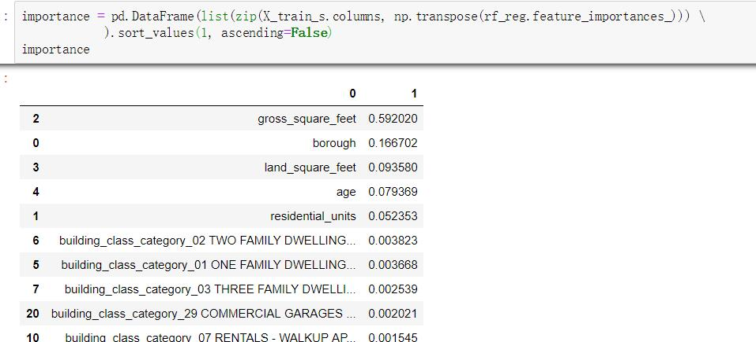
Some early implementation results that you may have got
Third time, we use features scaling to standardize and normalize all features which can make the distance between values of different feature have same effect to our model and make the GD faster.

Slide 15
The team's plan for the remaining phase of the project
Try other regression models.
Try some ensemble learning.
Add or drop features according to features importance and correlation matrix.

Slide 16
Team members and Task allocation.
Zimo Liu, CWID: 10430497, emal: liuzimo22@gmail.com
Task: data scraping, data engineering, model construction, model refine.
Yifan Ding, CWID: 10427456 , email: yding21@stevens.edu
Task: data source selecting, data engineering, model construction, model refine.
Xinqi Bao, CWID: 10430137, email: xbao2@stevens.edu
Task: data scraping, data engineering, model construction, model refine.

